Slide 1
Level Calibration Analysis
Prepared by
Rick Ales
5/20/2025

Slide 2
Executive Summary
Purpose: Evaluate the capability of repeatability and reproducibility of measuring and calibrating the Level Process Variable (PV).
Based on comparing the confidence limits of twelve, 5-point calibrations conducted by 4 operators (3 calibrations each) to their composite regression, which is assumed to be the best estimate of the true calibration coefficients, the 5-point calibration resulted in a worst-case Measurement Uncertainty Interval (MUI) of about ±0.004”

Slide 3
Overview
This analysis has two parts:
Analysis of the individual measurement Repeatability & Reproducibility, aka Composite data.
Analysis of the goodness of a 5-point calibration.
The coefficients of the best fit of the composite measurements (all 60 observations) are considered the best estimate of the true calibration coefficients, aka “Best Cal”.
The 5-point calibration is an evaluation tool to verify the “Best Cal” is valid for ATP testing to proceed.

Slide 4
Composite Data Set Measurements
DEFINITIONS
Obs Measurement Number
Oper Operator ID
Oper Rank Order of Variance from ANOVA
Operator Operator Name
Level Which quintile of the full level range for the measurement.
Set Point 5 observation points per calibration. The FULL point is fixed at 2.75”, EMPTY is fixed at 8.4” while the three intermediate points are the quintile levels +/- random amount ranging over 0.100”.
Laser Level Value read by the LK-G3000 Keyence Laser
Measure Level Value from the Depth Gage entered by the Operator
Cal ID the number assigned to a 5-point calibration
Goodness the maximum residual from 5-point calibration regression
Slope & Intercept coefficients resulting from 5-point calibration regression.
•••

Slide 5
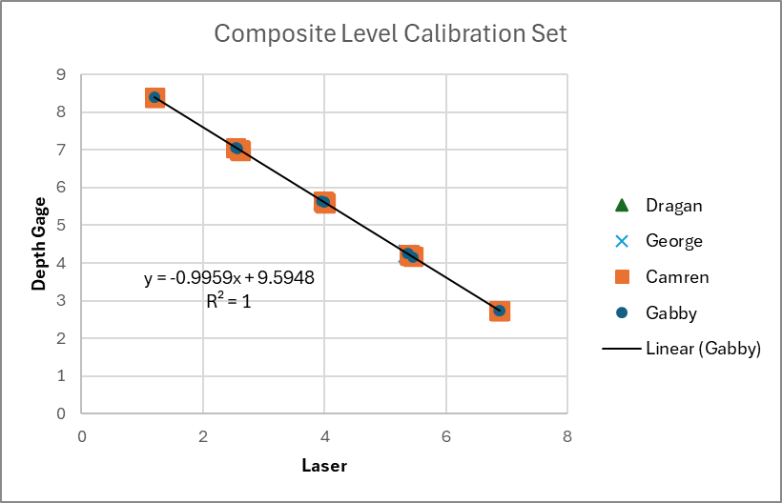
Composite Measurement Regression
Best Cal: Best estimate of calibration coefficients

Slide 6
Residual Plot & ANOVA Against Best Cal
ANOVA with Gabby
H₀: There is no reproducibility difference between operators.
H_{A}: There is a significant difference between operators.
Since P-value is > 0.05 can NOT reject H₀
**Post Hoc analysis show a significant difference between Dragan and Gabby (rank 1 to rank 4).

Slide 7
Compare Measurement Residuals with and without Gabby
Indicates there is a significant difference in the shape of the distribution tails.
ANOVA sans Gabby
H₀: There is no reproducibility difference between operators.
H_{A}: There is a significant difference between operators.
Since P-value is < 0.05 Reject H₀ Accept H_{A}
**Post Hoc Tukey analysis would be warranted to compare operators.

Slide 8
Composite Data Set Calibrations
DEFINITIONS
Full =7 This is the Lazer reading to give near Full Level measurement.
Empty=1.2 This is the Laser reading to give near Empty Level measurement.
Best Full Residual from this calibration fit to the Best Cal fit at the Full point.
Best Empty Residual from this calibration fit to the Best Cal fit at the Empty point.
The idea is to assess the individual 5-point calibrations against the Best Cal.

Slide 9
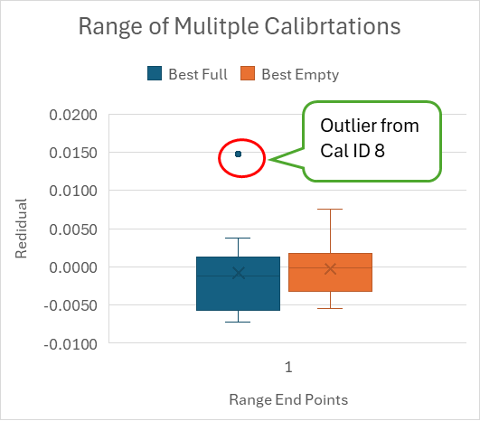
Calibration v Best Cal Residuals Statistics
Cal ID 8 with a “Goodness” score of 15 is suspect and generated this outlier. Should it be eliminated from the analysis?
Cal ID 5 with a “Goodness” score of 13 is marginal?

Slide 10
Calibration Full & Empty Reproducibility
H₀: There is no reproducibility difference between operators.
H_{A}: There is a significant difference between operators.
Since P-value is >> 0.05 can NOT reject H₀

Slide 11
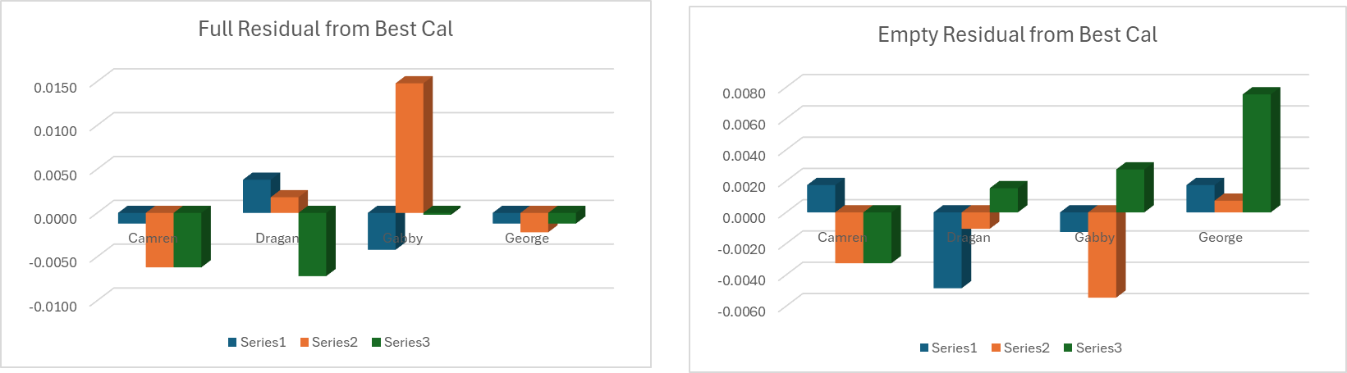
Calibration Full & Empty Reproducibility Plot
Best Cal compared to disregarding Cals 5 & 8

Slide 12
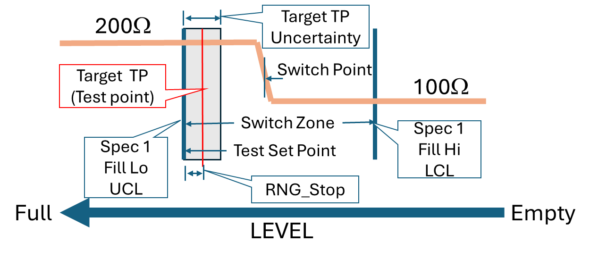
Measurement Uncertainty Interval
Type I Error is a false positive, Accept a Bad part.
Type II Error is a false negative, Reject a Good part.
Type II Error
OLS Transitions Here but evaluated at TP2
MUI
0.008”
TP 2
TP 1
Spec Limit
Type I Error
OLS Transitions Here
But evaluated at TP1
NOTE: Level Calibrations only assesses the PV portion of the level controller, an additional error is introduced by the control algorithm to accurately achieve TP by PV-SP=0.

Slide 13
To Be Done
Two additional tests are required to validate QTP suitability:
ATP Repeatability – Measure several parts multiple times and evaluate repeatability.
ATP Accuracy – Measure several “good” parts and “bad” parts and evaluate accuracy to discriminate between parts with NO Type I and acceptable (TBD?) Type II error rate.
Determine what is the acceptable System Measurement Uncertainty to set Target TP (see previous slide).
Determine the “Goodness” Criteria for flagging a calibration verification issue prior to ATP Testing.
Do we need a Resistance Calibration GR&R?
DONE – DONE Signed off ATP Spec and QTP.

Slide 14
Composite Level Calibration Data
FROM: …\PM_Folder\_4 Validation\QA Gage R&R \$MLOI_CalRecord QA GR&R.xlsx

Slide 15
Composite Level Calibration Data cont’

Slide 16
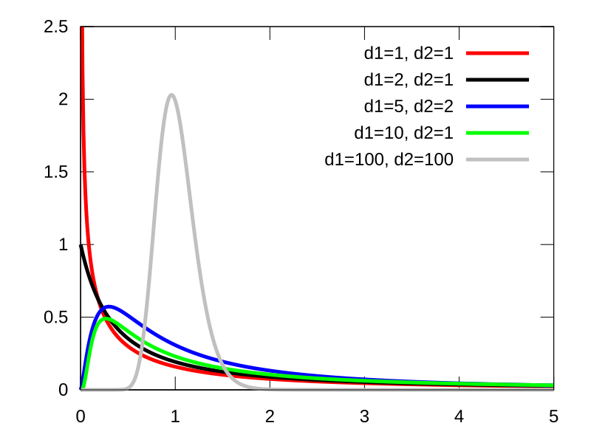
F-Distribution for ANOVA
The F distribution is designed for use in situations where we wish to compare ratio of two variances, or more than two means that arise from two or more samples taken from a normally distributed population. The degrees of freedom in the numerator (d1) is the number of factors -1 while the degrees of freedom of the denominator (d2) is the number of measurements -1.

